Slide 1

WebRTC Team
IIT Bombay Summer Internship 2016
Members -
Omkar Damle - DA-IICT
Rishabh Verma - NIT Silchar
Yash Trivedi - VIT University
Mentors -
Mr. Harish Satpute
Mr. Santosh Shingare

Slide 2
Whiteboard sharing
Mentor - Mr. Harish Satpute
Mr. Santosh Shingare
-By Omkar Damle
DA-IICT

Slide 3
Front end technologies
Fabric JS canvas library
Extensive use of socket.io library for socket communication with server.
Basic HTML, CSS and JavaScript
Back end technologies
nodeJS
express

Slide 4
Comparison with last week’s paint app
Fabric js library used which offers excellent features. One main feature used is treating all entities as objects on canvas.
In previous application, I was sending the entire canvas by converting it into data url. Here I only send the object properties in JSON format.
More features added compared to previous one.

Slide 5
Features
Free hand brush (width and color adjustable)
Types
Pencil brush (in-built)
Spray brush (in-built)
Circle brush (in-built)
Horizontal
Vertical
Square
diamond

Slide 6
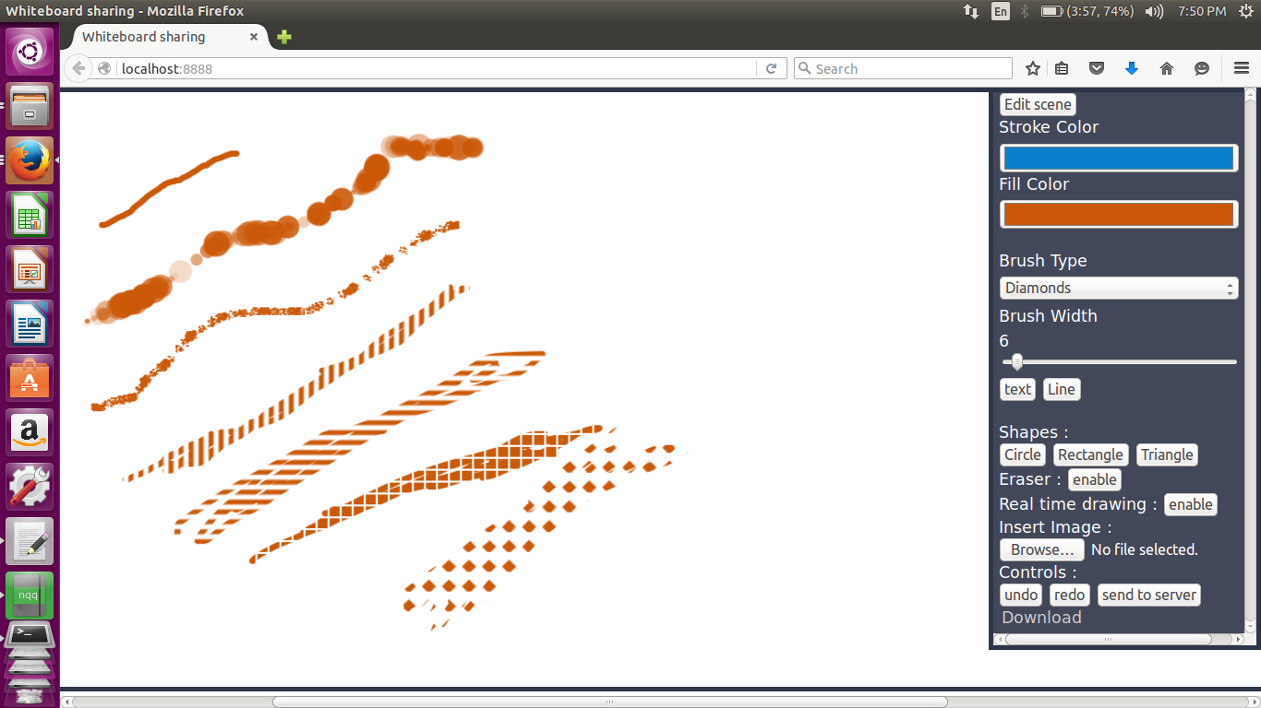

Slide 7
Features
Shapes
Types
Circle
Triangle
rectangle
- Line
- Eraser
- Real time drawing

Slide 8
Features
Text box (Real time text editing)
Image insertion from desktop file
Controls
- Undo*
- Redo*
- send canvas to server
- Download as png file

Slide 9
Two modes of operation
1. Draw mode
- for drawing on canvas
Edit Scene (extensive use of object model offered by fabric.js)
- for editing already drawn objects
- Can change stroke and fill of shapes
- can move around and resize objects
- can change text
- delete objects (no need to erase !)
- page up and page down buttons to bring objects forward or backward
- clear canvas

Slide 10
Demo

Slide 11
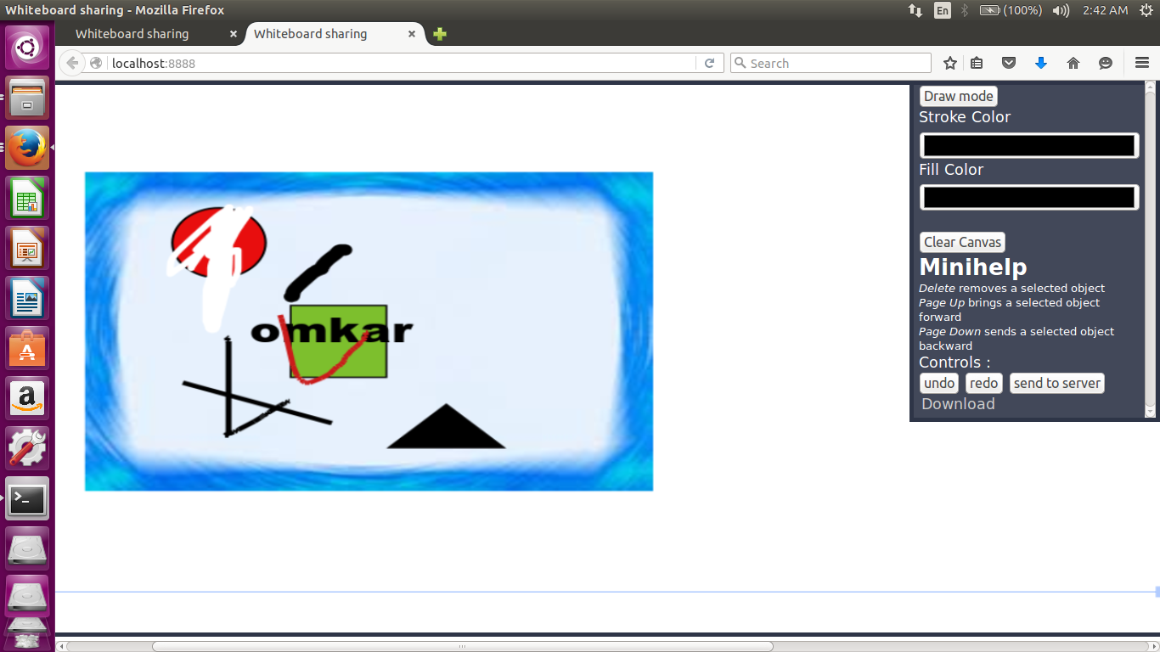

Slide 12
Future possibilities
Combining with last week’s module which had room and admin feature and users could join specific rooms.

Slide 13
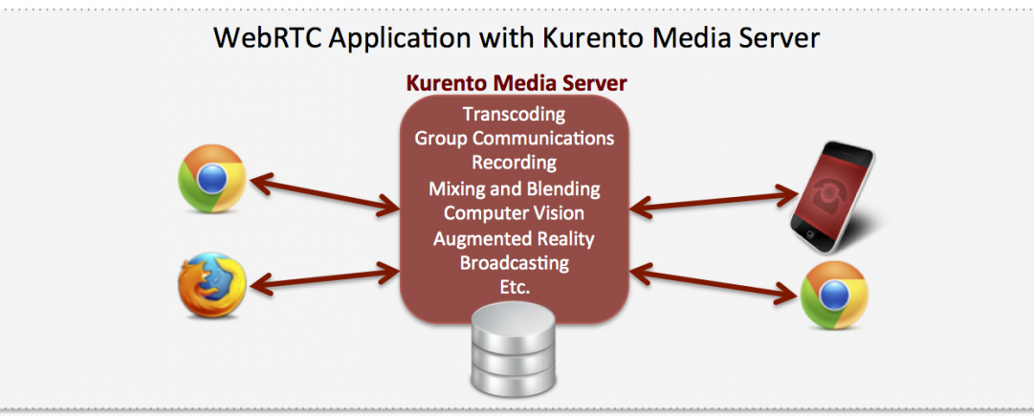
Kurento Media Server
Kurento is an open source WebRTC media server.
Kurento Media Server features include group communications, transcoding, recording, mixing, broadcasting and routing of audiovisual flows.
There are available Kurento Client libraries in Java and Javascript to control Kurento Media Server from applications.

Slide 14
KMS Features -
KMS Clients -
Networked streaming protocols, including HTTP, RTP and WebRTC.
Group communications (MCUs and SFUs functionality) supporting both media mixing and media routing/dispatching.
Generic support for computational vision and augmented reality filters.
Using the Kurento JavaScript Client directly in a WebRTC enabled browser.
Using the Kurento Java Client in a Java EE Application Server.
Using the Kurento JavaScript Client in a Node.js server.

Slide 15
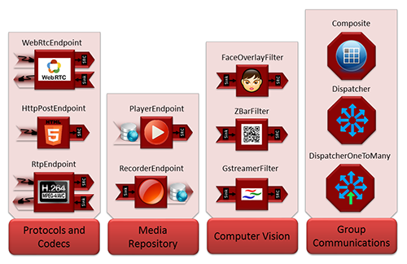
Media Elements -
Kurento Client API is based on the concept of Media Element.
A Media Element holds a specific media capability.

Slide 16
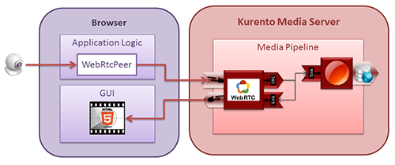
Media Pipeline
A graph of connected media elements is called a Media Pipeline.
When creating a pipeline, we need to determine the capabilities we want to use - the media elements - and the topology determining which media elements provide media to which other media elements - the connectivity.
Example - WebRtcEndpoint and RecorderEndpoint

Slide 17
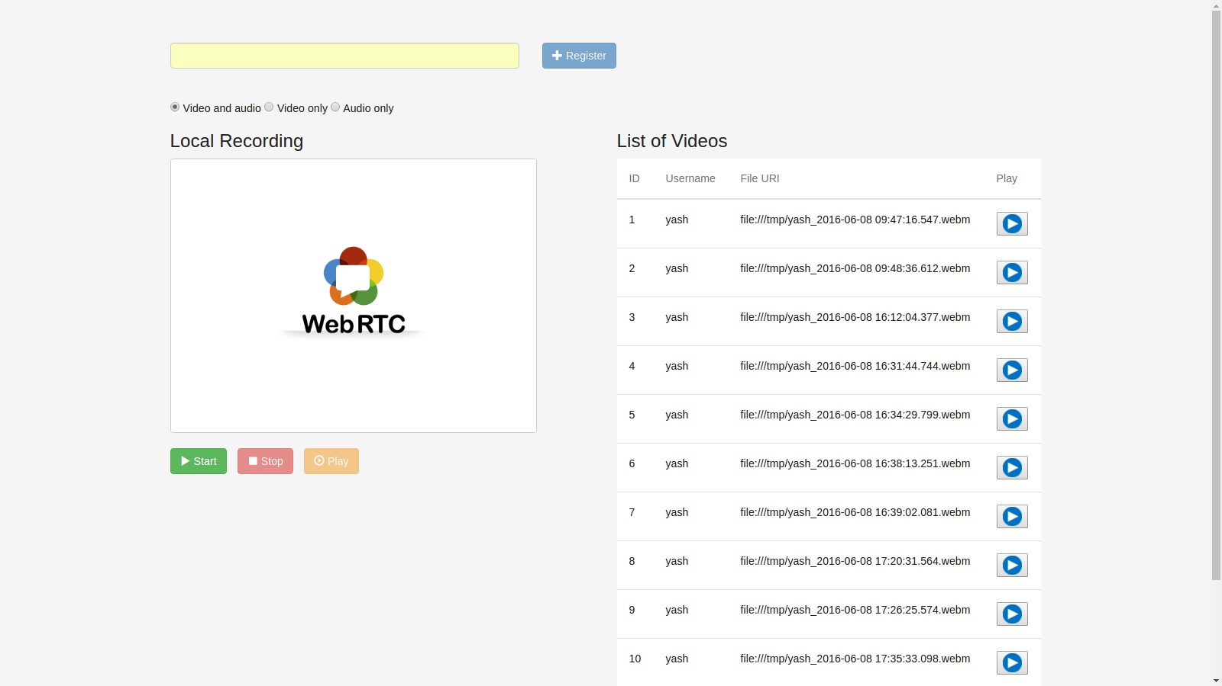
KMS WebRTC Recording and Playback -
Video Feedback portal.
Users can record and post video feedback.
Uses WebRTC for transmission of the audio and video.
Feedback videos can be retrieved and played later.

Slide 18
Key Technologies -
Client -
JavaScript + HTML + CSS.
JavaScript WebSockets API.
JSON custom signaling protocol.
Java Server -
KMS Java Client API.
Spring Framework.
Java WebSocket API.
JSON custom signaling protocol + Kurento Protocol.
MySQL database.
Kurento Media Server -
Kurento Protocol.
Media Pipeline and Elements.

Slide 19
Demo

